Slide 2
Brian Robeson is the main character of Hatchet. He is a 13 year old boy traveling by plane to visit his father in the oil fields in Canada. Before Brian boarded the plane, his mother gives him a hatchet. Brian is raised in the city and he doesn’t know that this one gift, just might make the difference between life and death.

Slide 3
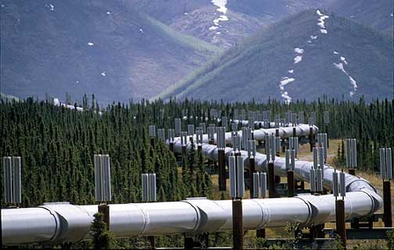
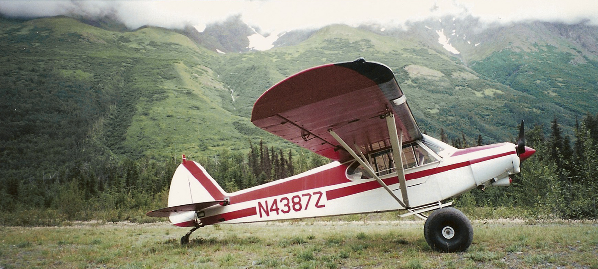
Notes:
What does his mother give him? Where is going? How is he going to get there?

Slide 4
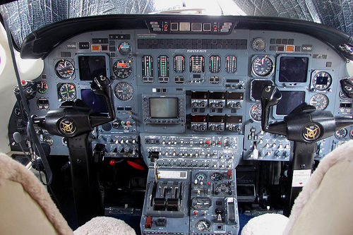
Problems
Problems start when the Pilot starts holding his shoulder and cries, “Chest! My Chest is hurting!” The pilot is having a heart attack and dies shortly after. Leaving Brian full control of the plane.

Slide 5
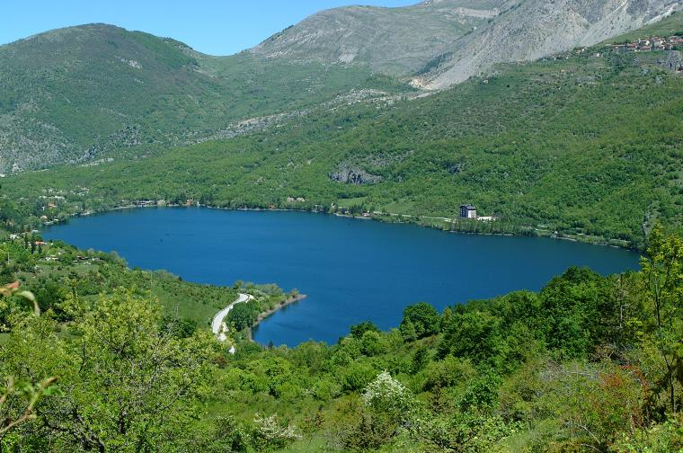
More problems
The plane runs out of gas and Brian crashes the plane into the lake.
Notes:
“L” Shape lake

Slide 6
Brian survives the plane crash and now must learn how to survive in the wilderness with nothing but his hatchet.
The story inside the story
Brian has been thinking about his parent’s recent divorce. Brian knows about his mother’s secret.The Affair with another man.

Slide 7
Notes:
Have you ever been out in the wilderness? What are few items did you have with you?

Slide 8
Besides worrying about finding shelter, food, and water, Brian understands that his needs
fire!

Slide 9
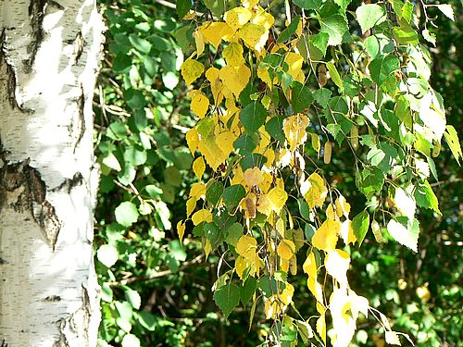
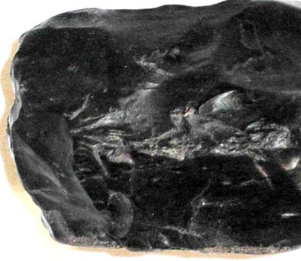
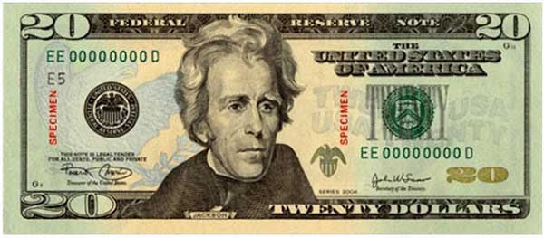
Notes:
What does Brian use to make fire?- Black rock (flint), Hatchet, Birch, and his twenty dollar bill. What is missing? –A steady stream of air.

Slide 10
Notes:
I see plants, trees and rocks. What else can be out in the wilderness?-Animals.

Slide 11
Few animals that Brian encounters in the wilderness
Notes:
What are some animals that Brian encounters?

Slide 12
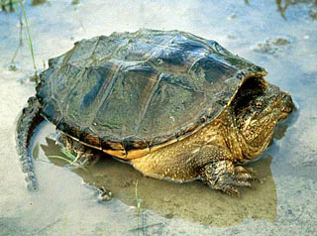
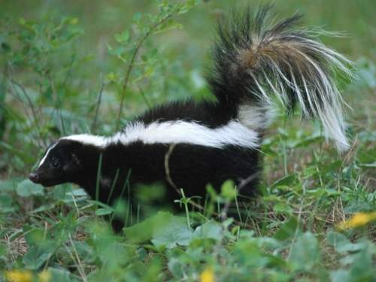
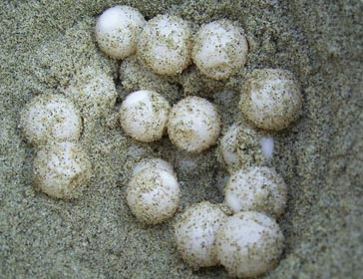
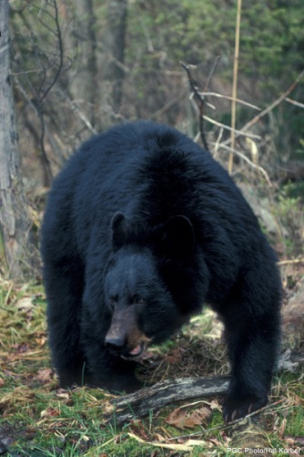
Skunk
mofeta
Snapping Turtle
la tortuga
Porcupine
espín
Black Bear
Oso

Slide 13
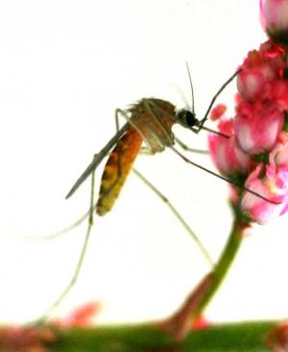
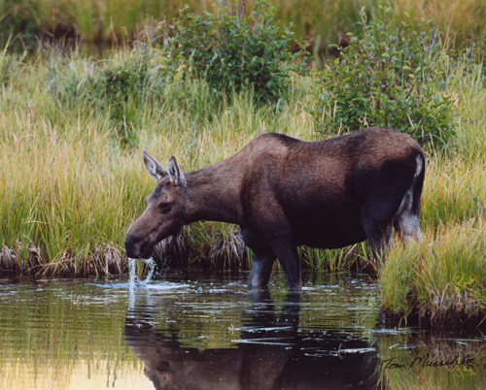
Other creatures that Brian encounters in the wilderness
Mosquitoes
Female Moose
Mosa
http://websolutionsbycody.com/hatchethooligans/index.htm
Notes:
Click on the link to learn more about creatures that Brian encounters.

Slide 14
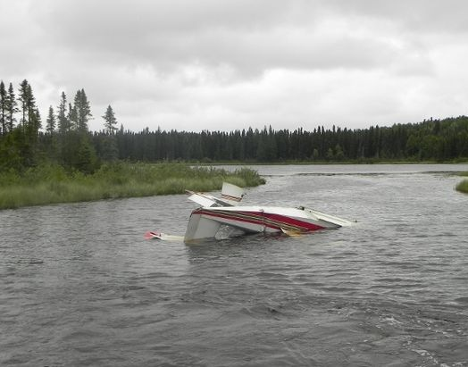
When the tornado hit the lake, it caused the crashed plane tail to appear.
Notes:
What was in the plane?

Slide 15
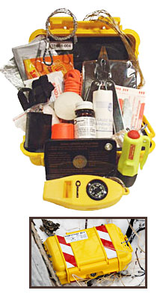
What was in the plane?
Notes:
Emergency transmitter

Slide 16
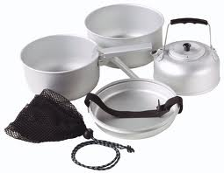
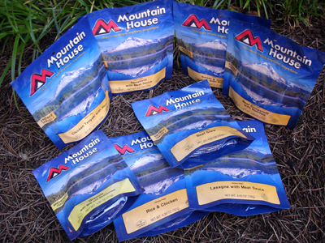
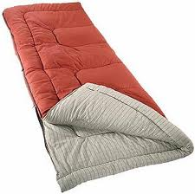
What was in the Survival Kit?

Slide 17
The Survival Kit from the Plane
sleeping bag,
an aluminum cookset with four little pots,
two frying pans,
a fork, knife and spoon,
a waterproof container with matches
two small butane lighters,
a sheath knife with a compass in the handle, a first aid kit with bandages,
tubes with antiseptic paste,
small scissors,
a fishing kit with four coils of line, dozen small lures, hooks and sinkers.
a survival rifle and emergency transmitter.

Slide 18
Notes:
With the Survival Kit at hand, how do you think Brian feels about his surroundings? -Home

